Slide 1
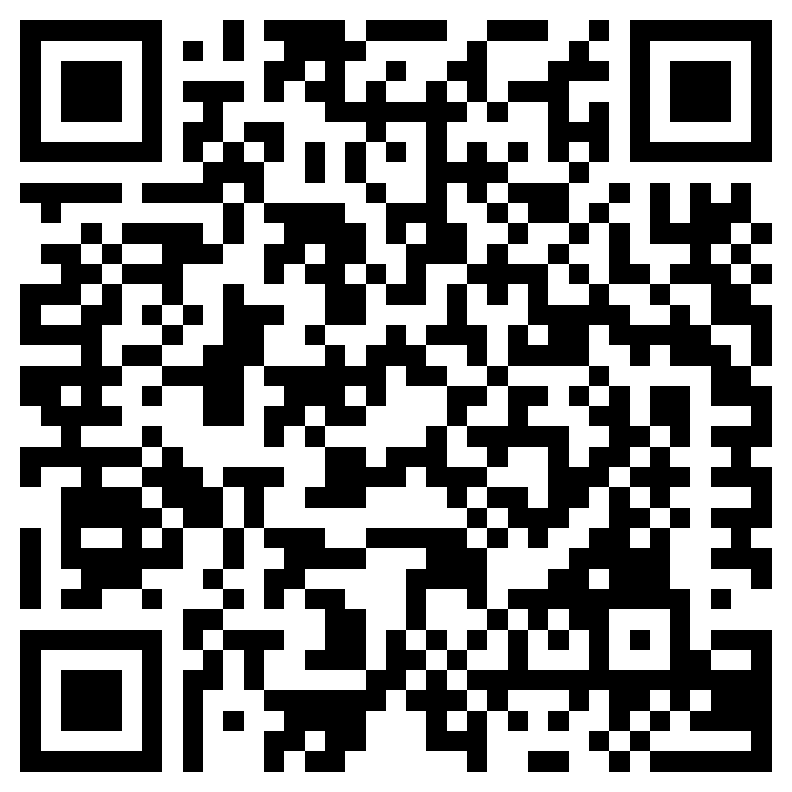
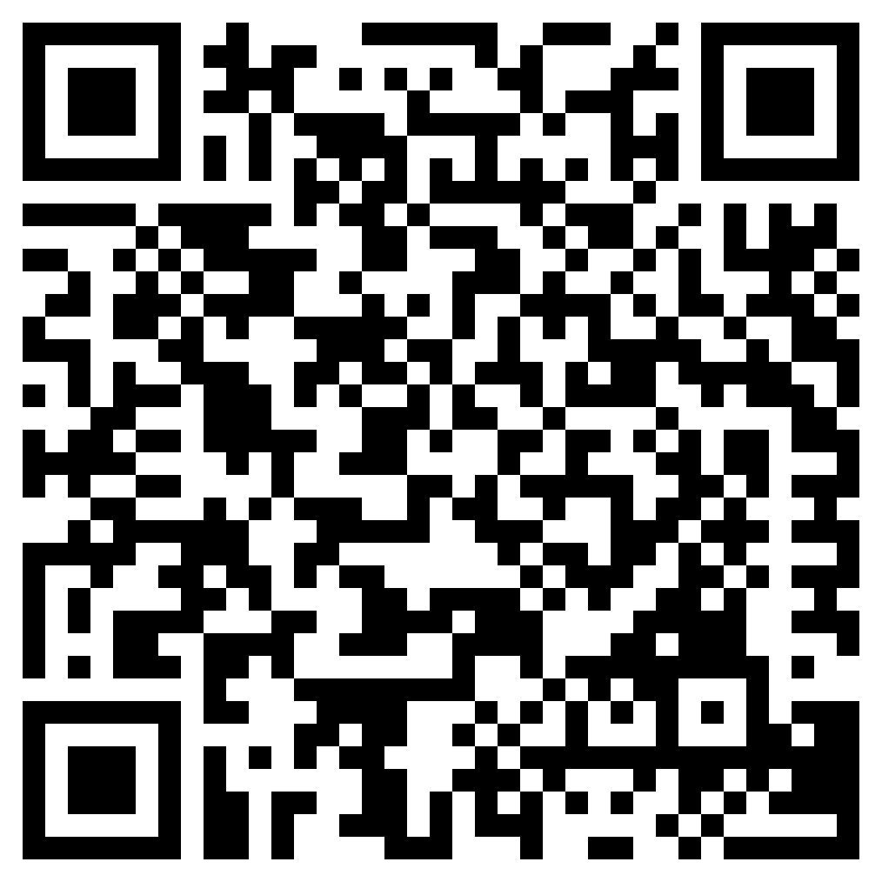
Uploader
Follow this link or scan this QR code to upload your ideas
Gallery
Follow this link or scan this QR code to go to the custom gallery
https://www.lego.com/sustainability/buildthechange/challenges/apl/upload?CMP=EMC-LCE
https://www.lego.com/sustainability/buildthechange/challenges/apl/gallery?CMP=EMC-LCE

